Slide 1
Estar with conditions and emotions

Slide 2
Estar
As you have already learned, the verb estar is used to talk about how you feel and to say where people, places, and things are located. Estar is also used with adjectives to talk about certain emotional and physical conditions.
Use estar with adjectives to describe how people feel, both mentally and physically.
Two important expressions with estar that you can use to talk about conditions and emotions are estar de buen humor (to be in a good mood) and estar de mal humor (to be in a bad mood).

Slide 3
Estar: To be
Yo Estoy | Nosotros Nosotras Estamos
Tú Estás | Vosotros Vosotras Estáis
Ud. Él Está Ella | Uds. Ellos Están Ellas

Slide 4
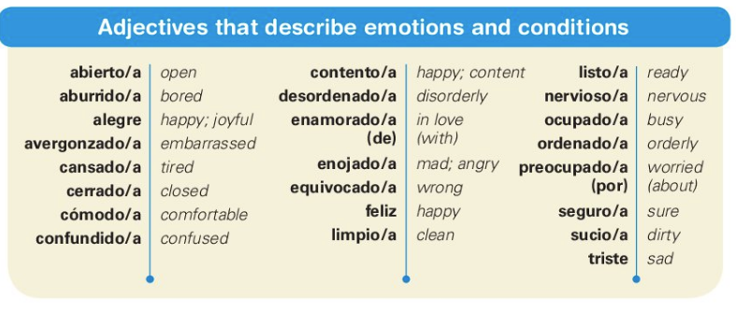

Slide 5
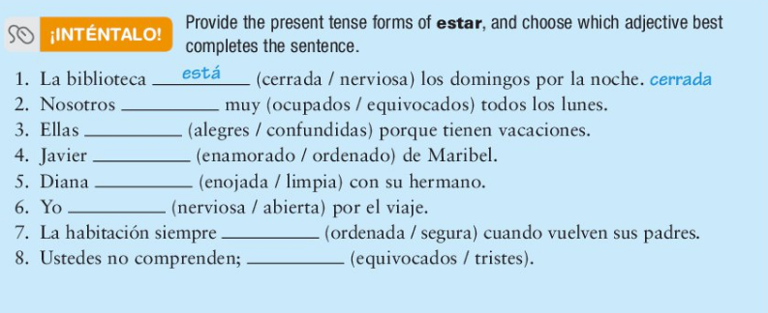
estamos
ocupados
están
alegres
está
enamorado
está
enojada
estoy
nerviosa
está
ordenada
están
equivocados

Slide 6
Translate the following:
The girl is worried about her classes.
The students are happy and are ready for the vacation.
We are very tired and confused.
Why are you dirty?
The female guest is embarrassed.
The elevator is open.
La muchacha/chica está preocupada por sus clases.
Los estudiantes están contentos y están listos para las vacaciones.
Estamos muy cansados/as y confundidos/as.
¿Por qué estás sucio/a?
La huésped está avergonzada.
El ascensor está abierto.

