Slide 1
Demonstrative Adjectives
(Not this one but that one!)

Slide 2
¿Qué son?
We use the demonstrative adjectives to help be a bit more specific.
For instance you might say….
I want this book, not that one.

Slide 3
These type of adjectives go IN FRONT of what we are talking about.
Just like any other adjective, they need to modify the noun in the same gender and number!

Slide 4
This and These have “T”s
Este Este libro es muy interesante. This book is very interesting. | Estos Estos libros son muy interesantes. These books are very interesting.
Esta Esta pizza es deliciosa. This pizza is delicious. | Estas Estas pizzas son deliciosas. These pizzas are delicious.

Slide 5
That and Those DON’T!
Ese Ese libro es muy interesante. That book is very interesting. | Esos Esos libros son muy interesantes. Those books are very interesting.
Esa Esa pizza es deliciosa. That pizza is delicious. | Esas Esas pizzas son deliciosas. Those pizzas are delicious.

Slide 6
That and Those WAAAAYYYY over there!
Aquel Aquel libro es muy interesante. That book (way over there) is very interesting. | Aquellos Aquellos libros son muy interesantes. Those books (way over there) are very interesting.
Aquella Aquella pizza es deliciosa. That pizza (way over there) is delicious. | Aquellas Aquellas pizzas son deliciosas. Those pizzas (way over there) are delicious.

Slide 7
¡Vamos a practicar!
Use the correct form of este, ese, or aquel to identify the pictures on the slides.
Based on your vocabulary knowledge, indicate which demonstrative adjective would be used to describe the indicated items.

Slide 8
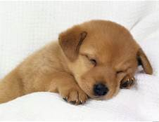
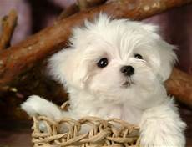
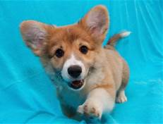
Ejemplo
Since the puppy is closer to us
We would use “Este” for
“Este perro”

Slide 9
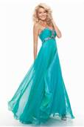
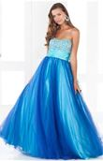
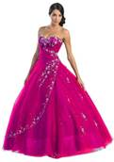
#1
Ese vestido

Slide 10
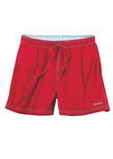
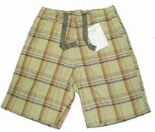
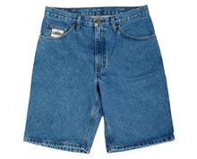
#2
Estos pantalones cortos

Slide 11
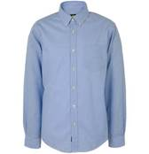
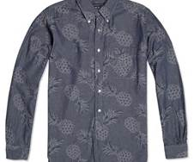
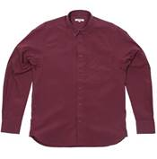
#3
Esta camisa

Slide 12
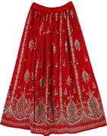
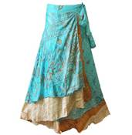
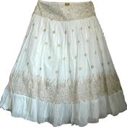
#4
X 2
X 2
X 2
Esas faldas

Slide 13
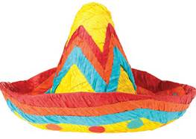
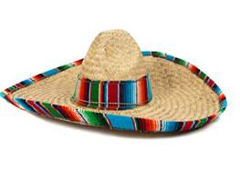
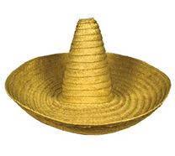
#5
Aquel sombrero

Slide 14
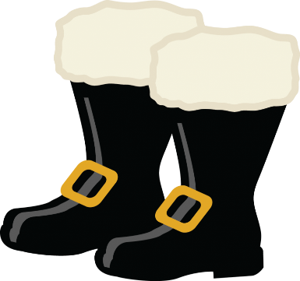
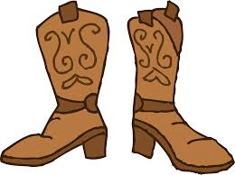
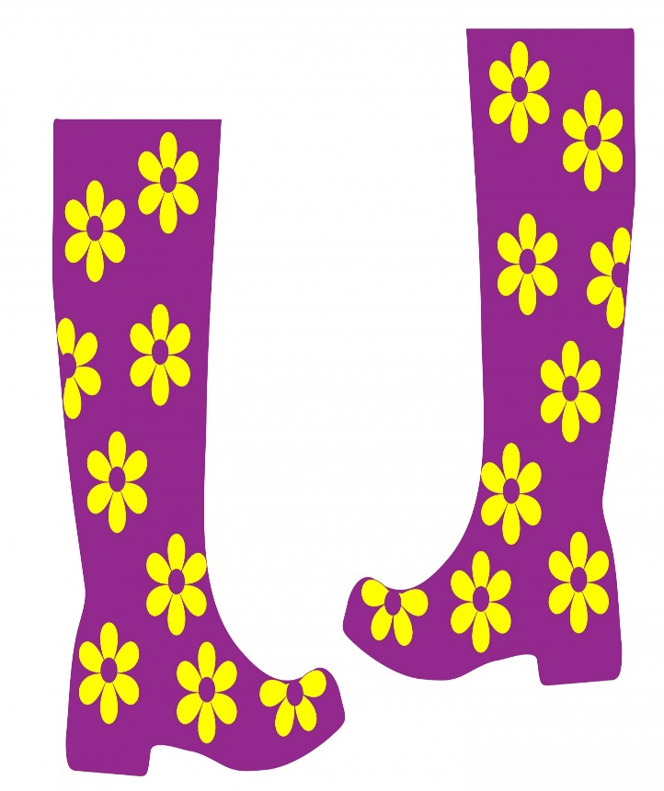
# 6
Estas botas

Slide 15
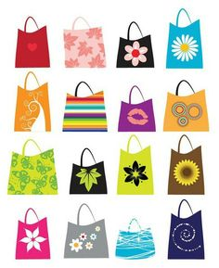
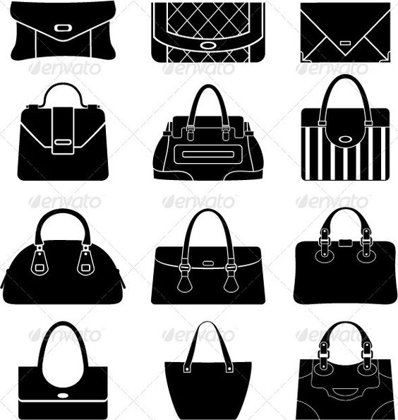
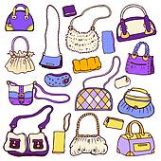
# 7
Aquellas bolsas

Slide 16
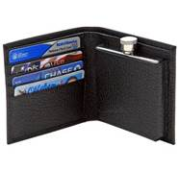
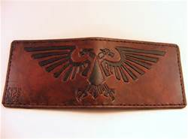
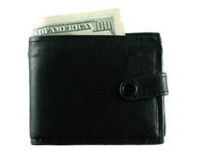
#8
Esta cartera

Slide 17
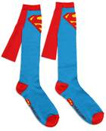
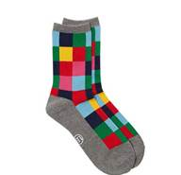
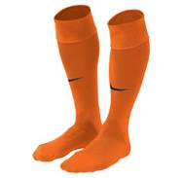
# 9
Esos calcetines

Slide 18
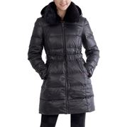
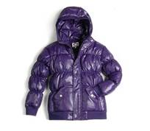
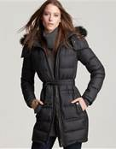
#10
Aquel abrigo

Slide 19
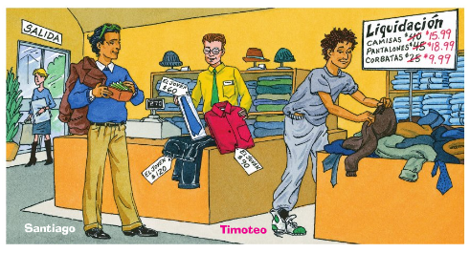
Marta

