Slide 1
Capítulo 3 Los Adjetivos

Slide 2
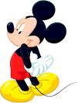
Los Adjetivos
Are used to talk about what you and others are like. (They describe people and things.)
In Spanish, most adjectives have both masculine and feminine forms.

Slide 3
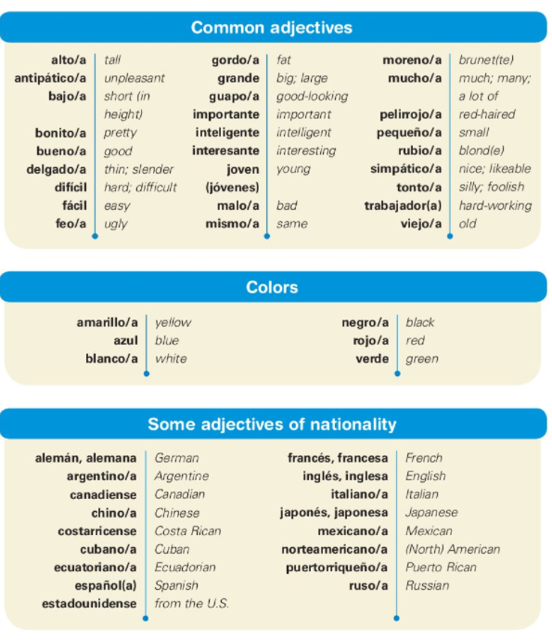

Slide 4
Masculine Adjectives
Are used to describe masculine nouns.
Ex. Marcos es alto y rubio.
(Marcos is tall and blond.)

Slide 5
Feminine Adjectives
Are used to describe feminine nouns.
Ex. Marta es simpática.
(Marta is nice.)

Slide 6
Other Adjectives
Adjectives that end in –e describe both masculine and feminine nouns.
Ex. Anita es inteligente.
(Anita is intelligent/smart.)
Ex. Pedro es inteligente.
(Pedro is intelligent/smart.)

Slide 7
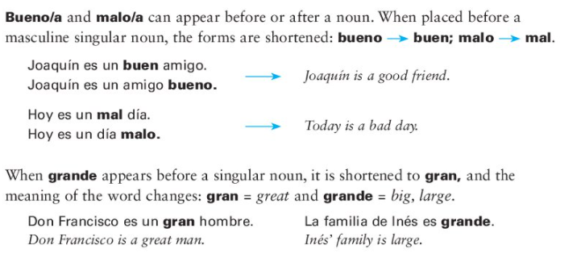
Mal y Gran

Slide 8
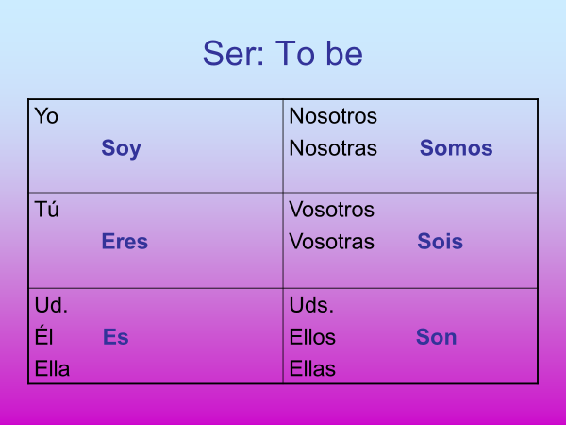

Slide 9
The verb ‘ser’
(Yo) soy: I am
(Yo) no soy: I am not
(Tú) eres: You are
(Usted) es: You are (formal)
(Él/Ella) es: He/She is
(Nosotros/as) somos: We are
(Vosotros) sois: You all are
(Ustedes) son: You all are
(Ellos/Ellas) son: They are
This verb is used to describe someone or something.
Ex. Laura es trabajadora. (Laura is hard-working.)

Slide 10
¡Vamos a practicar!
Translate the following sentences:
1. Susana is unpleasant.
2. Pablo is fat.
3. I am red-haired.
4. I am not old.
Susana es antipática.
Pablo es gordo.
(Yo) soy pelirrojo/a.
(Yo) no soy viejo/a.

Slide 11
¿Cómo es?
Fill in the blanks with the correct adjective.
(joven, gran, alta, bonita, guapo, antipático)
1. Me gusta el muchacho.Él es muy __________.
2. Elena no es baja. Ella es ___________.
3. Él no es simpático. Es _____________.
4. Mi amigo no es viejo. Es un chico muy __________.
5. Claudia no es fea. Es ___________.
6. Sr. Ramirez no es horrible. Es un _______ profesor.
guapo
alta
antipático
joven
bonita
gran

Slide 12
Making Adjectives Plural
Use the same rules that you learned when making nouns plural☺
If it ends in a vowel (a,e,i,o,u) add an ‘s’.
If it ends in a consonant (anything other than a vowel) add an ‘es’
If it ends in a ‘z’, remove the z and add ‘ces’

Slide 13
¡Vamos a practicar! Make the following plural
1. importante
2. rubia
3. tonto
4. joven
5. delgado
6. Feliz
7. trabajador
importantes
rubias
tontos
jovenes
delgados
felices
trabajadores

Slide 14
¡Vamos a practicar!
Translate the following sentences:
1. The parents are interesting.
2. The relatives are tall.
3. The daughters are pretty.
4. The grandson and I are not thin.
Los padres son interesantes.
Los parientes son altos.
Las hijas son bonitas.
El nieto y yo no somos delgados.

